Slide 1
Buddhist Psychology: From Trauma to Enlightenment
Session 2: How Trauma is Treated in Buddhism Context
Presented by Lotus Vu, CCC, Zen Teacher & Psychotherapist
Clear Way Zen, Regina, Saskatchewan

Slide 2
Covered in this session Early Buddhism’s Psychological Structure
Three Marks of Existence
Three Poisons
Twelve Dependent Origination
The Wheel of Samsara

Slide 3
Comparative View of Modern vs Buddhist Psychology
Buddhist Psychology on Trauma | Modern Psychology on Trauma
Pervasive in all of life | Clinical/pathological, occurring in defined circumstances
Failure of healthy response to environment | Failure of environment
Failure to recognize pervasive patterns leading to dissatisfaction stemming from the self | Failure to establish/ develop a healthy self
Becoming selfless and transcending the self to heal | Integrating fragmented self to heal
Focus on individual practice combined with community practice | Focus on individual therapy

Slide 4
Modern Psychology of Trauma vs. Buddhist Psychology of Trauma
Samsara – Cyclic Existence, where experiences of Dukkha (difficult to face) are consistently experienced.
Life is traumatic, no one is immune!

Slide 5
Three Marks of Existence
Anicca: Impermanent
Dukkha: Dissatisfaction / Difficult to Face
Annatta: No-Self/ Non-Self

Slide 6
Dukkha: Diffcult to Face/ Dissatisfaction
Being Born
loss of close physical connection to mother in womb.
Aging
loss of agency, youthful looks, mental acuity
Illness or decline of health
loss of capacity to function as before
Death
loss of everything to this life.

Slide 7
Dukkha: Diffcult to Face/ Disatisfaction
Being separated from what is pleasant/ desirable
loss of a loved one or thing you treasure
Having to face the unpleasant that one dislikes
loss of a sense of peace
Not getting what one wants
loss of hope
Being identified with the Five Aggregates (Forms, feelings, perception, mental formations, and consciousness).
Loss of one’s true nature (authenticity)

Slide 8
Three Poisons
The root cause of dissatisfaction (Dukkha)
Grasping or clinging to what is impermanent or not present
Avoiding the undesirable/uncomfortable/painful
Not understanding the nature of reality, not seeing things as they are!

Slide 9
Grasping
On Desire: Kama Sutta of the Suttanipatta

Slide 10
Avoiding: Ironic Processing Theory
Posits that sometimes our efforts to control our minds result in the opposite outcome of what we intended.
Rather than successfully suppressing or directing certain thoughts or feelings, we may inadvertently amplify them.
i.e. White Bear Experiment
Procrastination is a form of avoidance!

Slide 11
Pop Quiz Time!

Slide 12
Delusion: What we faulty Believe to be True!

Slide 13
Delusion: Dependent Arising

Slide 14
Delusion: The Main Cause of Suffering

Slide 15
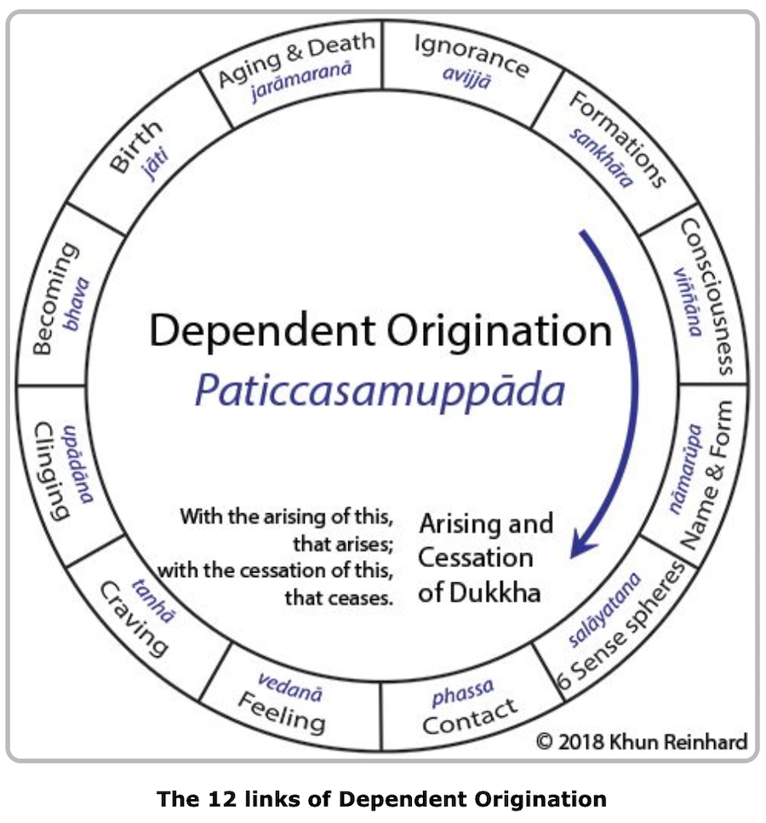
Dependent Origination
The Root Cause of Dissatisfaction (Dukkha) or Self-hood Process
Ignorance
Mental Formations (Sankhara / Karma)
(Personal) Consciousness
Name and Form (Mind & Matter)
Six senses gates
Contact
Sensations/ Feelings
Cravings/ Desires
Grasping / Attachment
Becoming / Existence
Birth
Aging/Decay & Death

Slide 16
Conditionings (Karma) | Dependent Origination | Can be seen in Jhanas combined with Mindfulness
Past Karma | Ignorance Mental Formations (Sankhara / Karma) (Personal) Consciousness | Niroda, 8, 7, 6
Present Karma | Name and Form (Mind & Matter) Six senses gates Contact Sensations/ Feelings Cravings/ Desires Grasping / Attachment Becoming / Existence | 5,4, 3, 2, 1
Future Karma | Birth Aging Decay & Death | 3,2,1

Slide 17
Breaking the Cycle of Dependent Arising
Contact
Sensations/ Feelings
Cravings/ Desires
Grasping / Attachment
Becoming / Existence
Being in 4th Jhana,
Equinimity
and mindfulness
Mindfulness
to Let Go!

Slide 18
Next Week
Going into the Deep End
with Buddhist Depth Psychology!
The Yogachara
For the ones up to the challenge, you can view these video series from the famous professor of Buddhism Jay Garfield.
The third turning of the wheel 1
The third turning of the wheel 2
The third turning of the wheel 3
The third turning of the wheel 4

Slide 19
References
Ansfield, M. E., Wegner, D. M., & Bowser, R. (1996). Ironic effects of sleep urgency. Behaviour Research and Therapy, 34(7), 523-531.
Wegner, D. M., Erber, R., & Zanakos, S. (1993). Ironic processes in the mental control of mood and mood-related thought. Journal of Personality and Social Psychology, 65(6), 1093.
Wegner, D. M., Schneider, D. J., Carter, S. R., & White, T. L. (1987). Paradoxical effects of thought suppression. Journal of Personality and Social Psychology, 53(1), 5.
Wegner, D. M. (1994). Ironic processes of mental control. Psychological Review, 101(1), 34.

