Slide 1
Buddhist Psychology: From Trauma to Enlightenment
Session 1: The Buddha, A Story of Trauma and Liberation
Presented by Lotus Vu, CCC, Zen Teacher & Psychotherapist
Clear Way Zen, Regina, Saskatchewan

Slide 2
Introduction
Clear Way Zen Community
My background

Slide 3
Disclaimer
Some contents of the course may be triggering to some individuals, as it is the course’s contents to discuss various aspects and experiences of trauma.
When triggered:
Take a break and practice deep breathing to ground yourself, leave the room if necessary, or talk with your therapist (if you have one).
This course is NOT a substitute for individual therapy.
Spiritual Bypassing isn’t recommended!

Slide 4
Course Structure
Theoretical
Readings/homework
Class lecture(1-1.25 hours)
A taste of the application in class (15-30 minutes)
A pop-quiz during class
A prize at the end of the course for perfect attendance and best score.

Slide 5
Covered in this session
Introduction
Overview of course structure
The story of the Buddha and how it relates to trauma
A brief overview of how trauma is defined in modern clinical psychology
Two modern psychological theories underlying the experience of Trauma and its comparative alignment with Buddhist concepts
The impact of trauma on mental, emotional, and physiological processes.

Slide 6
The story of the Buddha

Slide 7
What’s traumatic about this story?
Loss:
Loss of his birth mother as a child
Loss of ability to engage in the real world, being too sheltered (delayed to launch). Failure to gradually introduce dissatisfaction in life.
Abandoned his wife and child (repeat of trauma cycle)
“Primitive Agony”(Winnicott, 2016)
A state of intense fear or anxiety that can't be easily described. This fear of breakdown was a defense mechanism against unbearable anxieties that arise when someone experiences a failure of their environment.
During infancy, a breakdown in the bond between mother and infant can occur. The infant is forced to deal with emotional events they can't manage
The infant creates defense organizations to short-circuit their experience of primitive agony
This defense organization becomes the default mode of operations, establishing the core unconscious patterns of the infants who developed into adulthood.

Slide 8
Attachment Theory
Developed by John Bowlby and Mary Ainsworth (1950-1990s)
Humans have evolved to be socially connected with others for safety, security and survival.
The blueprint for this evolutionary intimate connection is formed during early development with the primary caregiver called the “Internal Working Model” (Bretherton, 1990)
If the primary caregiver is responsive to the infant’s needs, secure attachment is formed. If the caregiver is not responsive, insecure attachment is formed.

Slide 9
Attachment Theory & Buddhist Teachings
Attachment Styles | Buddhist Concept (Three Poisons: clinging, avoiding, mindlessness or not present)
Secure – feels safe, relaxed, trusting with others | Not clinging, not avoiding, being present/aware of others and self
Anxious – not safe, overly clingy, lacks boundaries, not present | Clinging, not present
Avoidant – not safe, avoids others and self, | Avoiding/aversion, not present
Fearful – not safe, wants closeness and clings, then closeness triggers danger/fear, avoidance response | Clinging, Avoiding (aversion), not present

Slide 10
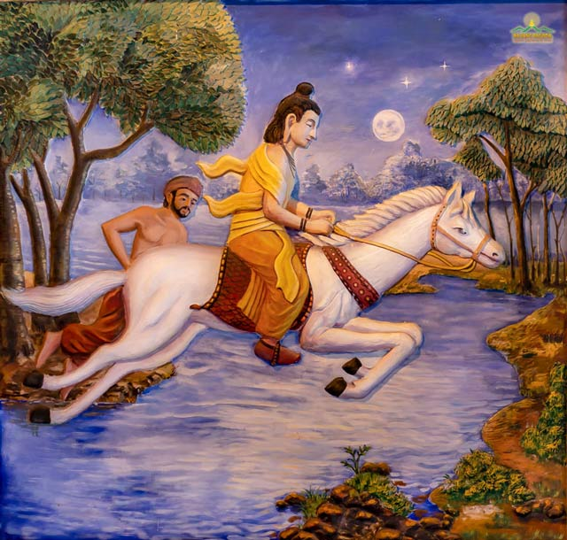
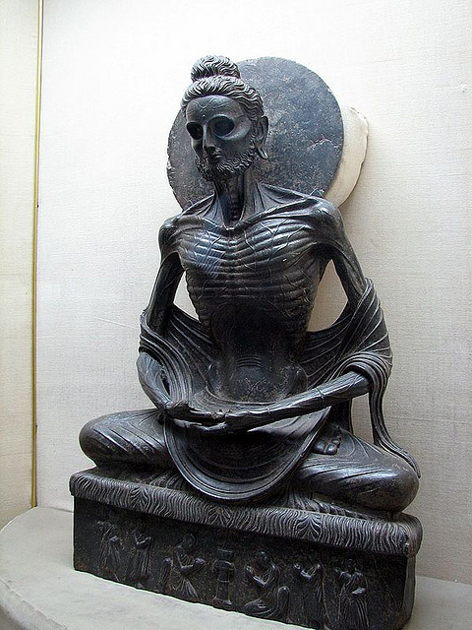
What kind of attachment style do you think Prince Siddhartha had before he became the Buddha?

Slide 11
PTSD and CPTSD (International Classification of Diseases ICD-11 Definitions:)
Post-Traumatic Syndrome Disorder
Exposure to an event or situation (either short- or long-lasting) of an extremely threatening or horrific nature.
Complex Post-Traumatic Syndrome Disorder
Exposure to an event or series of events of an extremely threatening or horrific nature, most commonly prolonged or repetitive events from which escape is difficult or impossible. Such events include, but are not limited to, torture, concentration camps, slavery, genocide campaigns and other forms of organized violence, prolonged domestic violence, and repeated childhood sexual or physical abuse.

Slide 12
What is PTSD and CPTSD?

Slide 13
Human Physiological Response System to Stress in the Environment

Slide 14
Polyvagal Theory on Trauma

Slide 15
Polyvagal Theory on Trauma

Slide 16
Window of Tolerance or Dysregulation

Slide 17
What did the Buddha Find Upon Enlightenment?
Life is dissatisfaction or full of difficult things to face (Dukkha)
This dissatisfaction is constructed by the three poisons, the twelve links of dependent origination and failing to accept the three marks of existence (Sameda Dukkha)
There is an optimal way of being to cease dissatisfaction/ sufferings. (Nirodha Dukkha)
The path to cease dissatisfaction varied (37 factors of enlightenment). It always contains 2 types of meditations: calm abiding (Jhana) and Mindfulness (Sati), and one boundary practice or Precepts (Sila), with the support of the Sangha (community of practitioners).

Slide 18
Modern Psychology of Trauma vs. Buddhist Psychology of Trauma
Samsara – Cyclic Existence where experiences of Dukkha (difficult to face) are consistently experienced.
Non-pathologizing view of dissatisfaction or suffering

Slide 19
What did the Buddha Practice to Gain Enlightenment?
Calm Abiding Meditation
Slows the breaths, lowers Heart Rate, relaxing tensions, grounded, focused on the present and breathing
Mindfulness
Dispassionately observes one’s internal experience without judgments; to discover and understand with open curiosity one’s internal experiences
Practicing Boundaries with Connections to Others
Living in harmony with oneself, others, society, the environment and connecting with others

Slide 20
Buddhism’s Concepts of Practice Relating to the Polyvagal Theory
Jhana / Samadhi Practice
lowers autonomic / stress arousal
Increases dopamine and serotonin levels (creating experience of contentment, calm & relaxation)
Increases window of tolerance
Mindfulness Practice
Generates insights and “wisdom mind” or witnessing presence.
Dispassionate observation of one’s habitual patterns to understand and change them
Balanced connected state of awareness
Community Practice
Taking Refuge in the Three Gems, establishing healthy boundaries with the Precepts, and healing and learning through connection with others who are also practicing the Dharma by applying the Six Harmony Principles for the Community.

Slide 21
It is all in the Breath and the Body!

Slide 22
Zen Practice Starts with the Body & Breath
Shao Lin Breathing Exercises (Qi Gong) works with the moving body

Slide 23
7-Minutes Breath Work Qi Gong Excercises

Slide 24
Questions? Comments?
See you next week!

Slide 25
References
Bretherton I, Munholland KA (1999). "Internal Working Models in Attachment Relationships: A Construct Revisited". In Cassidy J, Shaver PR (eds.). Handbook of Attachment:Theory, Research and Clinical Applications. New York: Guilford Press. pp. 89–114. ISBN 1-57230-087-6.
Winnicott, Donald W. (2016). The Collected Works of D. W. Winnicott/ 1960-1962. Oxford University Press.
Natarajan, A. (2023). Heart rate variability during mindful breathing meditation. Frontiers in Physiology, 13. https://doi.org/10.3389/fphys.2022.1017350

