Slide 1
Buddhist Psychology: From Trauma to Enlightenment
Session 3: Buddhist Psychology of the Unconscious
Presented by Lotus Vu, CCC, Zen Teacher & Psychotherapist
Clear Way Zen, Regina, Saskatchewan

Slide 2
Covered in this session
What is Yogachara?
The Three Natures (Cliff’s Notes version)
Eight Consciousnesses (Mental Factors)
Transformation of Consciousness
Four Ways of Knowing
Five Wisdoms
Asanga (4th century C.E.), Tibetan depiction.
Author of Yogācārabhūmi-Śāstra,
Verses Distinguishing the Middle and the Extremes, and
Adornment of Mahāyāna Sūtras

Slide 3
What is Yogācāra?
Yogacara means “Practice of Meditation”
A tradition of philosophy and psychology emphasizing the study of cognition, perception, and consciousness through the interior lens of meditation, and philosophical reasoning.
Founded by the brothers Asaṅga and Vasubandhu (4-5th century CE)
Yogācāra main concept is vijñapti-mātra or citta-mātra translated as “Mere Representation Only”
唯識 Wéishí (Chinese) or Duy Thức (Vietnamese) = “Knowing Only”
Yogacara is meant to aid the practice of Meditation and transformation

Slide 4
Three Natures (Trisvabhāva-nirdeśa) From Saṅdhinirmocana Sūtra (by Vasubandhu)
Imagined Nature (parikalpita-svabhāva)
Dependent Nature (paratantra-svabhāva)
The Perfected or The Consummate Nature (pariniṣpanna-svabhāva).
Vasubandhu (4th century C.E.), Chinese depiction.
Author of the Three Natures,
20 and 30 Verses on Consciousness Only

Slide 5
1. Imagined Nature: How do we see an Apple?
Nerve impulses go up my optic nerve into our brain.
They go into our occipital cortex, where various visual processing happens, and they interact with the parts of our brain that are involved with language and with motor control to give us the labeled “Apple”.
We need light to see the “Apple”, but our brain is dark. The Apple isn’t in our brain.
Complicated interaction between light, our eye and neural activity allowed us to construct an image of “Apple” in our brain.

Slide 6
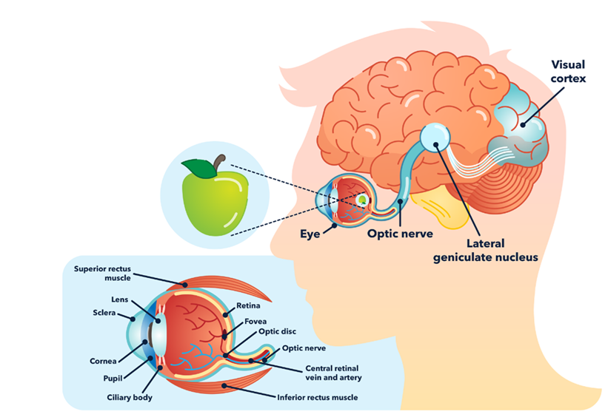
1. Imagined Nature: How do we see an Apple?
We see reality as:
Dualistic
Objected
But it is:
Imagined by complex processes of our brain
Projected as an image and a name
Image and name are not outside of our brain
What happens if I knock you unconscious?
You can’t eat and be full from an image and a name, but you think that what you are grasping is something from which you can be eating to be full.

Slide 7
2. Dependent Nature: Constructed & Empty
Emptiness of Characteristics (Yogachara) – Interiorly/Subjectively Empty
The apple we experience is happening in our brain! None of the characteristics we see or feel is outside of our neurons firings (which is not red, solid or tasty).
All we experience as “Apple” is empty of the characteristics we attributed to it. It’s a projection based on our evolutionary and biological makeup and construction, which doesn’t necessarily mean others see/experience it the same way.
Emptiness of Nature (Madhyamaka/ Middle Way) – Externally Empty
“Apple” is dependent on Causes and Conditions or Dependent Nature
Light to for us to see
Cellular structures and bonding, hardness, various parts etc…
“Apple” doesn’t exist because it is made up of all non-apple elements that come together temporarily.

Slide 8
3. Consumate Nature: What is really real?
The experience of the “Apple” that depends on all of these conditions is empty of that imagined external “Apple”
The dependent “Apple” in your mind is empty of subject-object duality, it’s not separate from you (there isn’t an apple if you didn’t imagined it); it is empty of externality; and so that is the ultimate emptiness of the “Apple”.
What we experience is our experiences are just mind!
Everything is subjective!
We don’t really know the objective reality!

Slide 9
3. Consumate Nature: Buddha Sees the World As
Unchanging reality of phenomena, free from the limitations of the other two natures. It is seen as the true nature of things, beyond conceptualization and duality.
Key Characteristics of the Consummate (Perfected) Nature:
Ultimate Reality or suchness(Tathātā): beyond the limitations of our perception and conceptualization. Pure basis of reality but is inexpressible.
Changelessness: permanent and formless
Non-Duality: a state of non-duality, where there is no separation between subject and object
Pacified: "free of desire," a state of emptiness and liberation from suffering arising from the three poisons.

Slide 10
How do the Three Natures work together?
Example:
Imagine a flower. From the perspective of the imaginary nature, we see a flower as a distinct object with specific qualities and characteristics. From the perspective of the dependent nature, we see the flower as arising from seeds, soil, and sunlight. From the perspective of the consummate nature, we see the flower as a manifestation of the underlying reality, beyond our conceptualizations and attachments.

Slide 11
Pop Quiz Time!

Slide 12
Conditioning through Yogachara
Seeds (cause) – karma (conditionings/ programing), dormant in the unconscious
Perfuming - Favourable Conditions 缘 (yuan/duyên), triggers or catalyst
Maturation (effect) – combined with favorable conditions and other conditions upon arising, to aid in maturing or slight changed of conditioning.
Re-stored (dormancy) – new matured conditions are again re-stored into the unconscious as new seeds

Slide 13
Applying the 3 Natures to Construction of Self According to Yogachara
We have 8 consciousnesses (working mechanisms of knowing) that work with each other to construct the self and reality.
5 consciousnesses belonging to sensory (eye, ear, nose, tongue, body/cakṣurvijñāna, śrotravijñāna, ghrāṇavijñāna, jihvāvijñāna, kāyavijñāna)
6th Consciousness or Mentalization (manovijñāna) – Thoughts, ideation, mental visual/ sensory images.
7th Consciousness (manas)/deluded awareness – source of “self-identity” and “self-perception”. A perceptive filter that creates duality: self and others. The gatekeeper that filters all arising of “seeds” from the unconscious.
8th Consciousness (ālāyavijñāna) – Storehouse Consciousness or the Unconscious (both individual and collective)

Slide 14
First 5 Consciousnesses of the Sensory
Requires 2 aspects: Formless aspect of Mind (Nama) and physical Form (Rupa)
Eye (physical form) + awareness (formless) = Eye consciousness
Nose (physical form) + awareness (formless) = Olfactory/Nose consciousness
Ear (physical form) + awareness (formless) = Auditory/Ear consciousness
Tongue (physical form) + awareness (formless) = Gustation/ Tongue consciousness
Body (physical form) + awareness (formless) = Somatosensory/Body consciousness
Puzzle for Modern Neuroscience and Artificial Intelligence: “Is awareness a function of the physical (brain), or is it something more?”

Slide 15
6th Consciousness of Mentalization
This mechanism turns everything received by the first five into a different form: “Mentalization,” which can be an object of perception.
Thoughts (transformed from sound input as language)
Images (transformed from sight input as visual mentalization)
Olfactory residuals (transformed from smell input as mentalization)
Gustastion residuals (transformed from taste input as mentalization)
Somatosensory residuals (transformed from body sensory as mentalization)
Mentalization Consciousness transforms sensory input and awareness into mental aspects and perceptions that can be stored and recalled differently than the original experience.
It turns every experience from the first five consciousnesses into something of mind that can be grasped.

Slide 16
7th Consciousness: Original Source of Self/ Deluded Awareness
Avijjā Vijñāna (無明 Non-Clarity) - Original Source of Self-Perception causing the deluded experience of “subject and object” duality
This filter operates below awareness, localizes experiences through the perception of “personal observer source,” and universalizes experiences through intuitive perceptions through the alayavijnana (collective unconscious)
It keeps the gate between unconscious and conscious awareness. It taints the conditioned seeds that arise into awareness with duality and self-perception, leading to further grasping and development of seeds.

Slide 17
8th Consciousness: Storehouse or Unconscious
Storehouse (ālāya-vijñāna) operates below awareness but encompasses all things above and below awareness
Only that which exists in the storehouse can exist in awareness
Store House is a repository of all conditionings (personal and impersonal), not accessible by awareness unless the right environment/conditionings present themselves for it to become conscious.
In a sentient being, it’s personal, going beyond the boundaries of perception or personal awareness; it’s impersonal (collective unconscious), which holds everything else.
By itself, Storehouse is neutral and reflexive.
Notes:
(to say it’s below awareness, because it’s our conditioned or biological inheritance to be able to perceive a certain range of things, in essence the line of above/below awareness doesn’t exists)
(as all things are projections of seeds from the storehouse)

Slide 18
Transformation of Consciousness How the Self is Created
1st Transformation: (ālāyavijñāna)
Occurs in the Storehouse Consciousness, where all things mental, its seeds (conditioned processes) are stored.
2nd Transformation: (manana)
Self-consciousness or self-view occurs. Subject and object duality begins in the stream of consciousness. Alaya is defiled by self-interest. No conceptualization has occurred yet.
3rd Transformation: (viṣayavijñapti)
The “concept of the object” develops, which gives rise to the propensity to “grasping” or “avoiding/aversion” of objects.
Vasubandhu is critical of this step, not because it relates to the conception of an object but because it generates grasping after a "real object" (sad artha), even when it is no more than a conception (vijnapti) that combines experience and reflection.

Slide 20
Four Ways of Knowing
Zen Meditation is a Process of Transformation of the 8 Consciousnesses – Post Kensho/Satori, one transforms the seeds of Karma (conditionings) or processes of the Self into Four Ways of Knowing:
Alaya-vijnana Storehouse Consciousness transforms into Knowing of the Perfected Mirror (reflecting things as they are = Thusness)
Manas-vijnana Consciousness (Egoic Essence/Perception) transforms into Knowing of Equanimity (all things are equal in nature/wisdom of non-discrimination = Emptiness)
6th Consciousness (thinking/ discriminating) transforms into Knowing of Clear Observation (purified Rational Mind in being able to process clearly without mental obstruction)
Five other consciousnesses transform into Knowing of Perfected Action (or the Perfected Mirror Knowing in the sense-consciousness)

Slide 21
Transformation of Consciousnesses
The way of knowing of the great reflecting mirror –mind clears
The way of knowing equality – mind without afflictions
The way of knowing through clear observation – absent of efforts
The way of knowing perfected action – all has been done
Five, six, seven, eight: the resulting fruits of planted seeds movements
It only uses labels, not the true nature of reality
If knowing knows without attachments
Amidst bustling activities, stillness liberates.
~Hui Neng, 6th Patriarch of Chan/Zen China (638-713 AD)

Slide 22
Five Wisdoms (Dharmadhatu) Appears when the Mind is Purified
Wisdom of Suchness or Emptiness – Bare non-conceptualizing awareness / non-duality
Wisdom of Mirror-Like Awareness – clearly reflecting what is
Wisdom of Equality/Sameness – sees all phenomena with commonality that which arises and falls as emptiness
Wisdom of Investigative Awareness – or sublime investigation without corruption
Wisdom of Accomplishing Activities – spontaneously completes all activities of five sensory consciousnesses without effort or goal.

Slide 23
Is Yogachara Idealism or Phenomenological?
This course is approaching it as Phenomenological and Epistemological, which can be applied to meditation practice.
Modern cognitive science has helped to explain some of the most complicated concepts of Yogacara.
Transformation of Yogacara isn’t done in isolation but in conjunction with everyday life through Zen practice.

Slide 24
Next 3 Weeks
The experiential Zen practices that put all of what we did in the last 3 weeks together!
3 training: Jhanas (Attention), Sati (Mindfulness), Sila (Boundaries
Community Practices (Early Buddhism and Mahayana Buddhism)
How does it relate to the Polyvagal Theory & Clinical Framework of Trauma Healing?

Slide 25
References
Low, A. (Ed.).(2006). Hakuin on Kensho: The four ways of knowing. Shambala.
Thích Thắng Hoan, (1992). Khảo nghiệm duy thức học. Patriarch Temple Buddhist Press.
Thich Nhat Hanh, (2002). Understanding Our Mind: 50 Verses on Buddhist Psychology. Berkeley, CA, Parallax Press.
Waldron, W.S.(2003). The Buddhist Unconscious: The ālāya-vijñāna in the context of Indian Buddhist thought. Routledge Curzon.
Waldron, W.S. (2023). Making sense of mind only: Why Yogācāra Buddhism matters. New York, Wisdom Publication.

