Slide 1
Buddhist Psychology: From Trauma to Enlightenment
Session 4: Buddhist Structure for Overcoming Trauma
Presented by Lotus Vu, CCC, Zen Teacher & Psychotherapist
Clear Way Zen, Regina, Saskatchewan

Slide 2
Covered in this session
Stages of Trauma Recovery
Dialectical Behavioural Therapy and Buddhism
Three Gems
Three Trainings

Slide 3
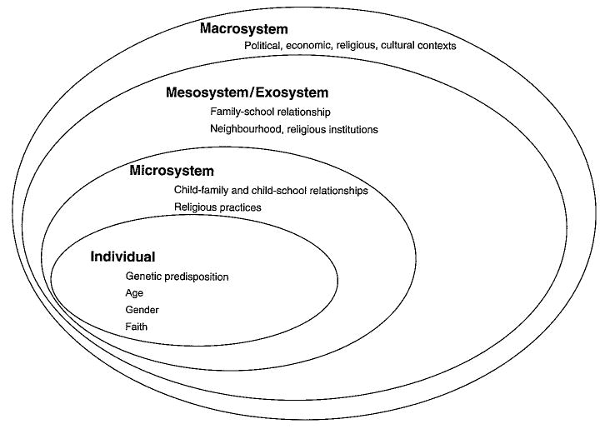
Research on Trauma and Social Support
Social support from family and community plays an important role in resiliency from Trauma.
Cultural and religious practices are factors in healing outcomes for children and adults.
Post-trauma support and acceptance from family and community improved outcomes of recovery.
Cultural practices demonstrated to help healing
The social ecological model of risk and protection for children affected by armed conflict (adapted from Bronfenbrenner, 1979)
Notes:
Sierra Leone has community-led traditional cleansing ceremonies as a part of a mental health intervention. Bundu initiation ceremonies are intended to rid young women of noro or spiritual pollution and bad luck that is thought to affect female survivors of war-related rape. Such ceremonies have been found to facilitate greater self-esteem and community acceptance (Stark, 2006).

Slide 4
Stages of Trauma Recovery in Treatment
Safety and Stabilization
Physical and emotional safety
Learning skills to regulate emotions, grounding and coping
Creating a sense of safety
Skills: Mindfulness, sensory exercises, yoga, art, music etc.
Processing and mourning the trauma
Processing emotions and losses
Confronting trauma memories, working with grief and difficult feelings
Making sense of experience
Reconnecting and Integrating with Meaningful Narrative
Developing resilience, reconnecting with oneself and others
Rebuilding relationships and community connections
Maintaining healthy coping mechanism, building support system, pursuing personal/professional goals to facilitate integration.

Slide 5
Dialectical Behavioural Therapy (DBT)
Developed by Marsha Linehan out of her Rinzai Zen experience.
For people with suicidal conditions or Borderline Personality Disorder (BPD) or C-PTSD.
4 Foundational Skills in Treatment:
1) Mindfulness,
2) Emotion Regulation,
3) Interpersonal Effectiveness,
4) Distress Tolerance.
4 Core Components of Treatment Structure:
1) Individual Therapy,
2) Skills-Training Group Therapy,
3) Phone Coaching,
4) Therapist Consultation Team

Slide 6
Why are 3 Gems Practice Healing?
A place for safety and support
A place for grieving
A place to learn skills (to living harmonious with others and oneself)
A place to build meaningful connections and relationships

Slide 7
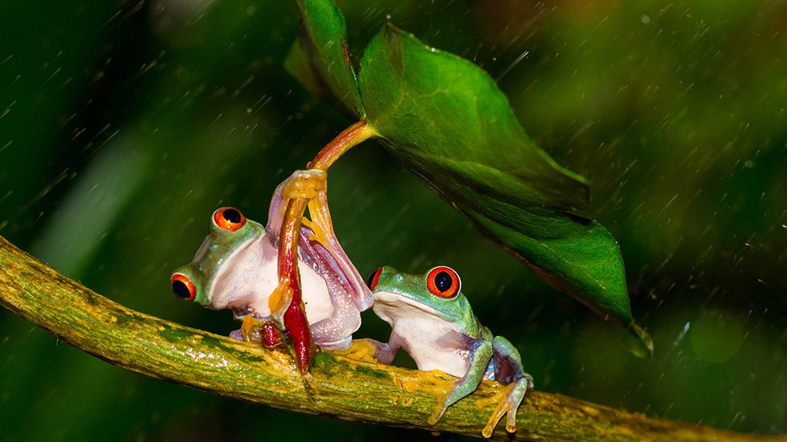
3 Refuges or 3 Gems
Creating Safety from Learning Skills of Wisdom and Harmony
Practiced with a guiding teacher, a community of 5+ people who also observe the same practice in supporting each other.
Meditate together, observe ethical boundaries together, observe harmony principles together, learn the dharma together, share good/bad experiences, share meals and work for the common good together.

Slide 8
Experience at a Typical Zen Retreat Center
Daily Rituals:
Daily meditations
Chantings
Daily Dharma Classes
Exercise (Martial Arts of Qi Gong)
Physical work (garden or kitchen)
Communal meals
3 Refuges (Buddha, Dharma, Sangha)
3 Trainings: Boundaries, Meditation, Wisdom (Sila, Jhana, Panna)
6 Harmony Principles of the Sangha (Harmony in having the same viewpoints, precepts, in living together, in speaking without conflict, in experiencing Dharma bliss from practice, in sharing benefits)

Slide 9
3 Refuges (Establishing Safety)
Purpose
Protection from fear
Confidence in the path
Gateway / prerequisite to path
Objects of Refuge
Therapist | Buddha - teacher
Trauma therapy | Dharma - teachings
Positive relationships | Community – social support

Slide 10
Healing Modalities in Post-War Vietnam
Ritualistic healing/ chanting to absolve past karmas (like a spiritual cleansing)
Ritualistic grieving practices, such as chanting/bowing to help beloved ones heal or reincarnate to a good place.
Group meditation
Group Qigong exercises or Free Herbal Medicine Clinics
Communal sharing and support for practicing together through volunteering and generosity.

Slide 11
The Skills of 3 Trainings
Jhanas Benefits
Slow breathing down
Relaxation of mind/body
Emotional regulations: establishing a lower baseline of relaxation and increase the window of tolerance
Meditation also shortens the duration of neural activity in the default mode network (reduces mind wandering)
Develops into deep mindfulness practice
Mindfulness Benefits
Insights into one’s patterns and behaviors
Acceptance to change
Continuous learning and changing
Boundaries (Sila) Benefits
Keeps one out of trouble (guards mental/emotional environment from upsetting)
Develops generosity and compassion
Practice humility (sangha karma)
Learning to live with others harmoniously

Slide 12
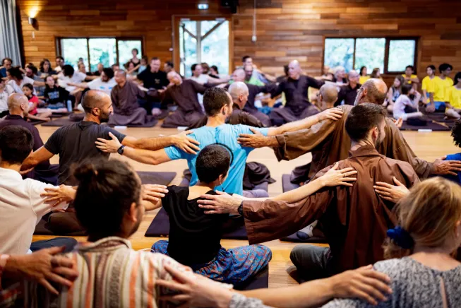
Zen Experience of 3-Gems Outside of Vietnam
Plum Village Sangha
Taught and run by Monastics
Supported and practiced by laity
Harmonious environment where people can practice and live together
Many report feeling renewed and peaceful after an experience at the retreat
Supported by retreatant fees, book sale revenues, and donations

Slide 13
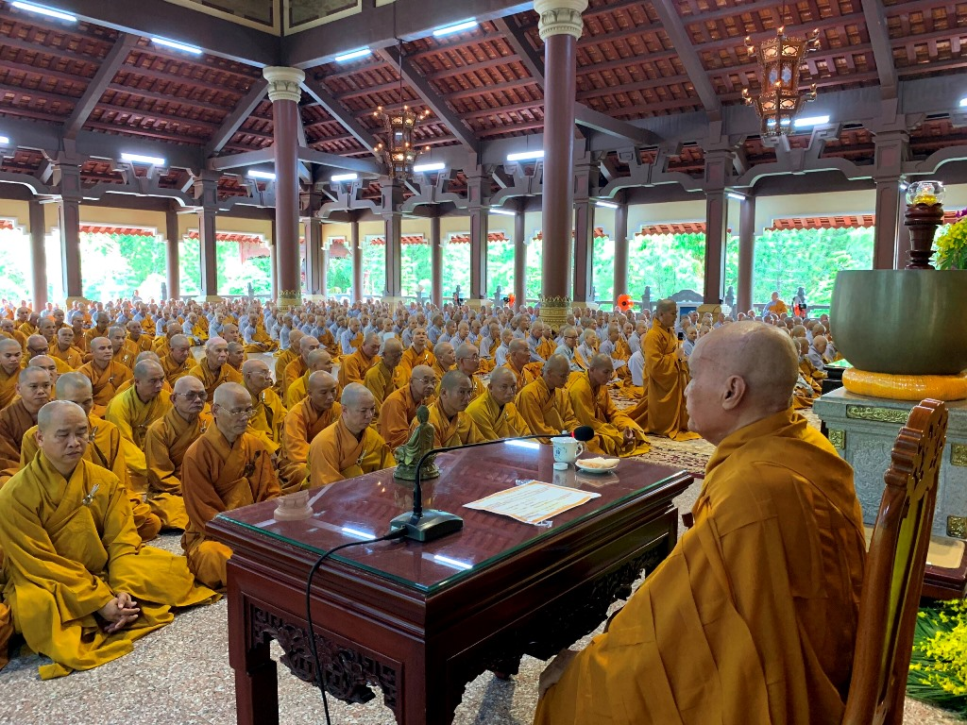
Zen Mainstream Experience of In Vietnam
Bamboo Forest School & Linji School
Sangha is seen as representing only the monastic (not as the Buddha intended).
Practice is mainly reserved for Monastics (no long-term stays for laity over 10 days group retreat)
Daily practice can include monthly regular retreat stays for laity
Solitary meditation retreats not offered for laity
Active laity community activities alongside monastics: volunteering, studying dharma, chanting, festivities.

Slide 14
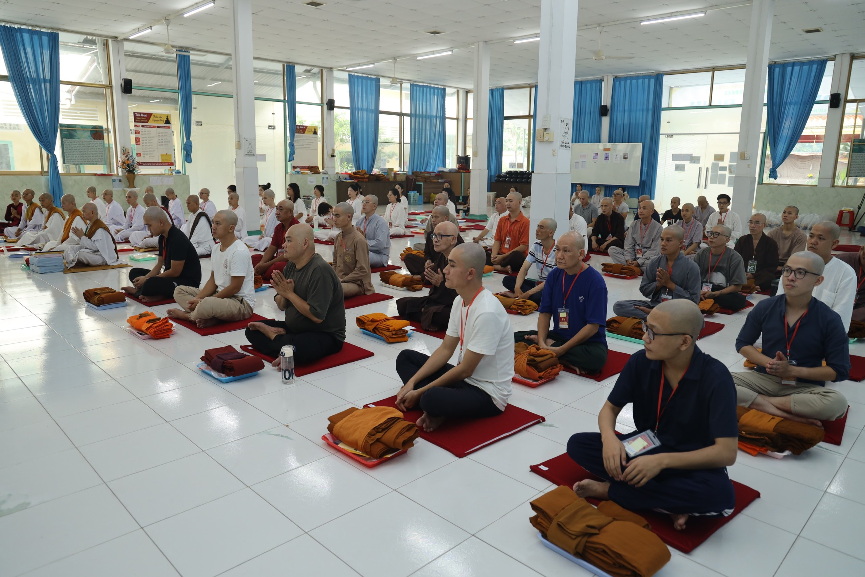
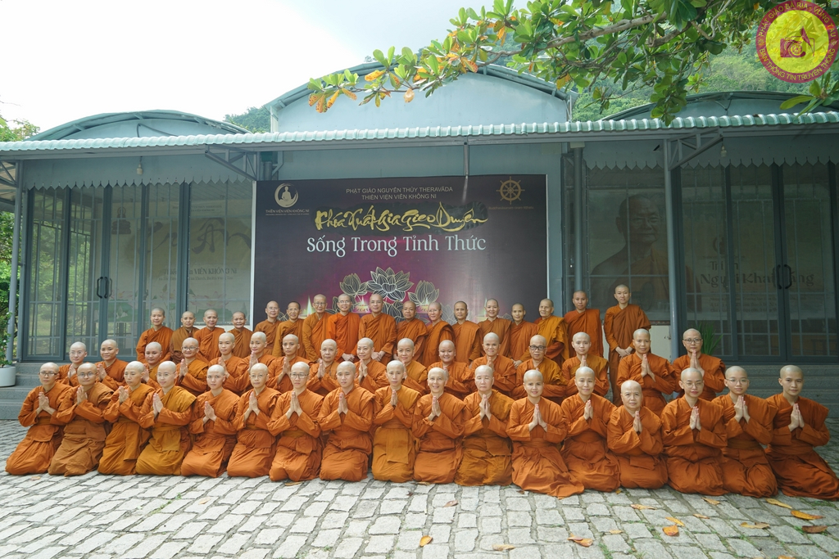
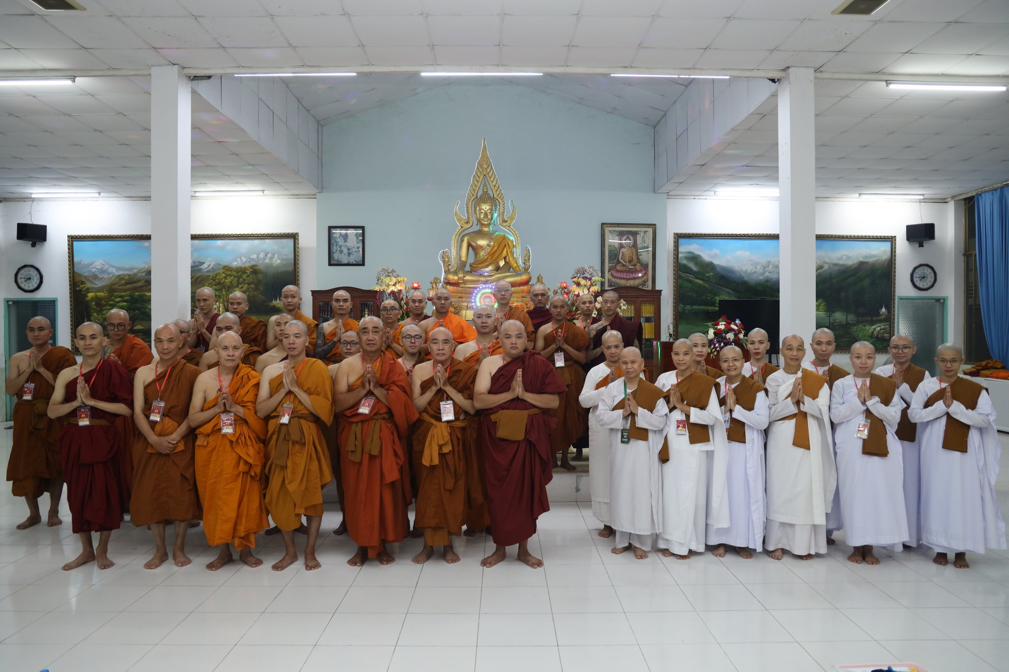
Theravada Mainstream Experience in Vietnam
Monastics are seen as sangha
Limited ordination for women
Temporary ordination for 10 days to 6 months stays
Jhanas are not taught for laity, mainly Vipassana
Growing movements pushing for women ordinations and laity practice

Slide 15
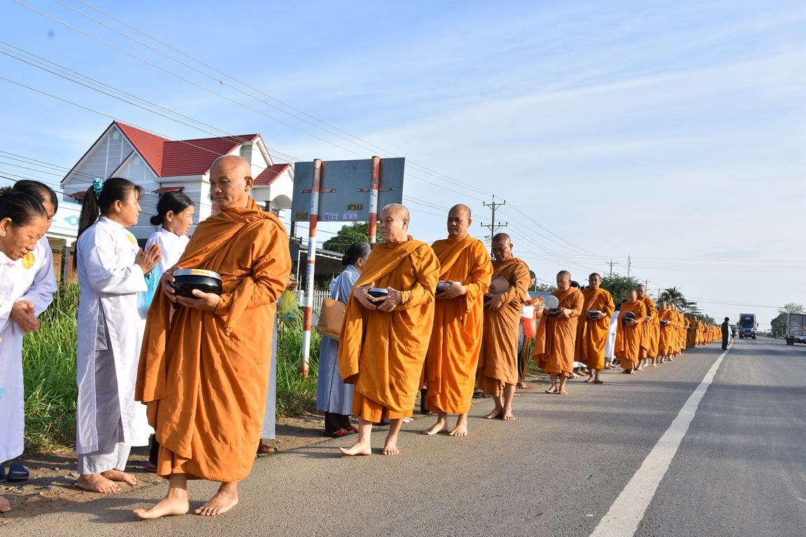
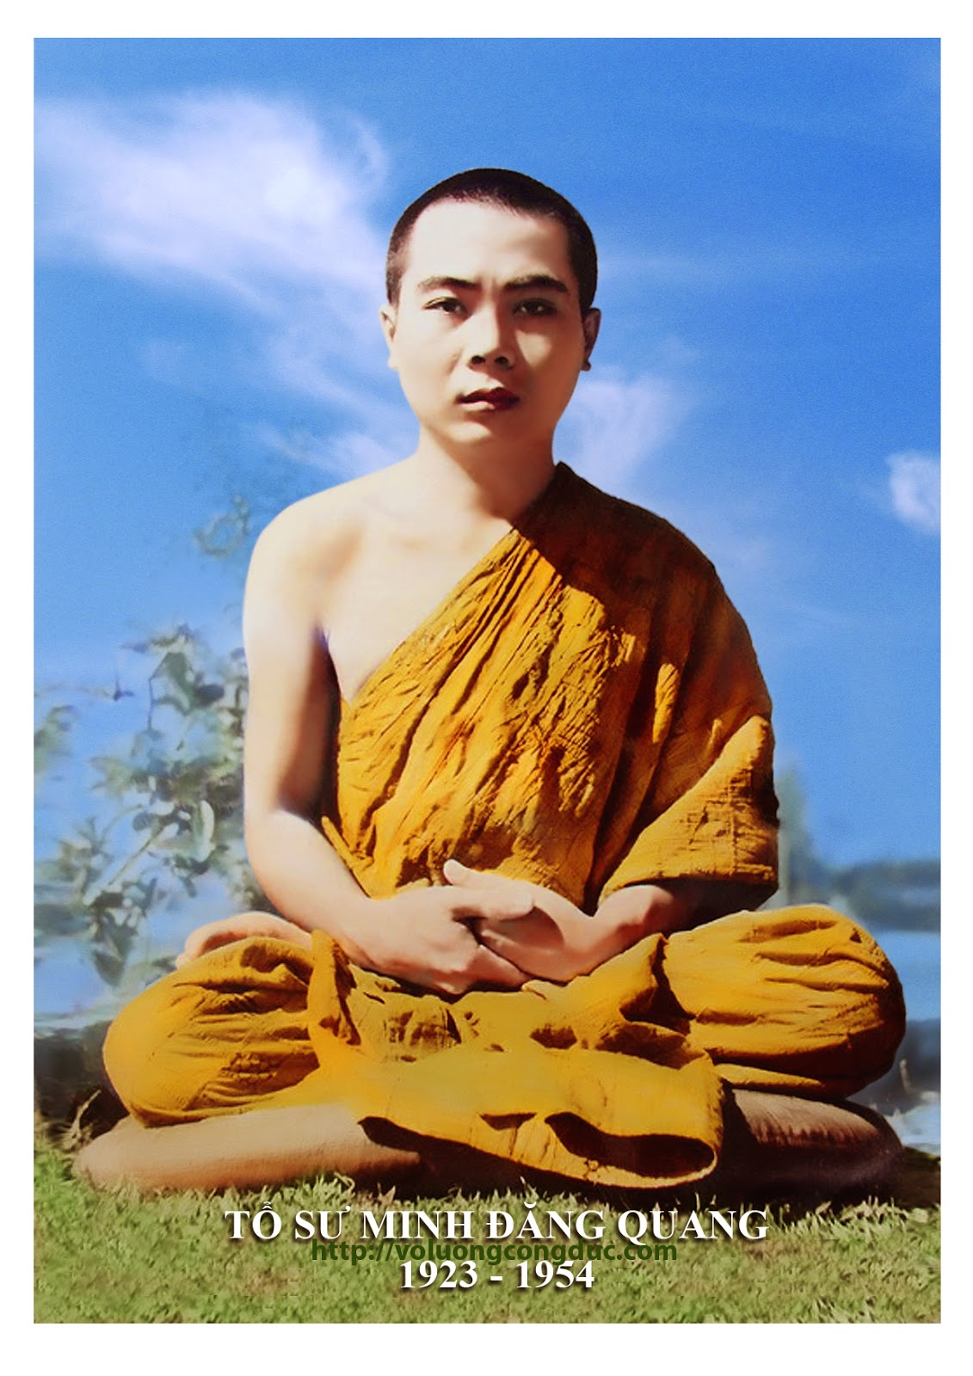
Medicant Buddhism Experience in Vietnam
Live and practice as in times of the Buddha
Emphasis on equality of women and men, equality of practice (Theravada and Mahayana)
Restricted by communist government. Medicant life converted to mainstream monastics. Many live a hermit lifestyle.

Slide 16
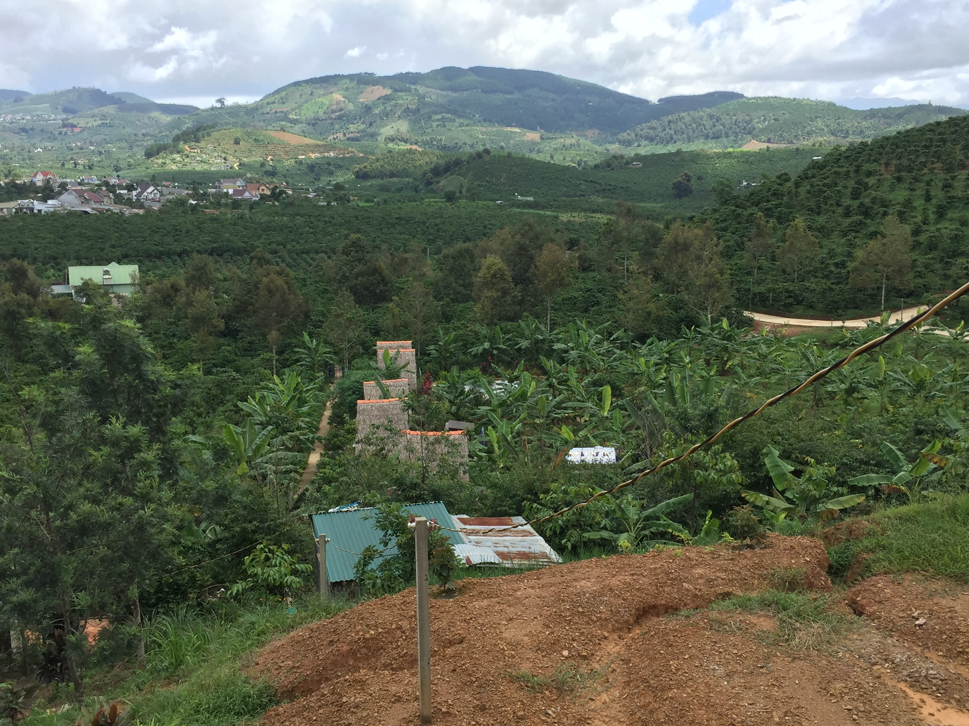
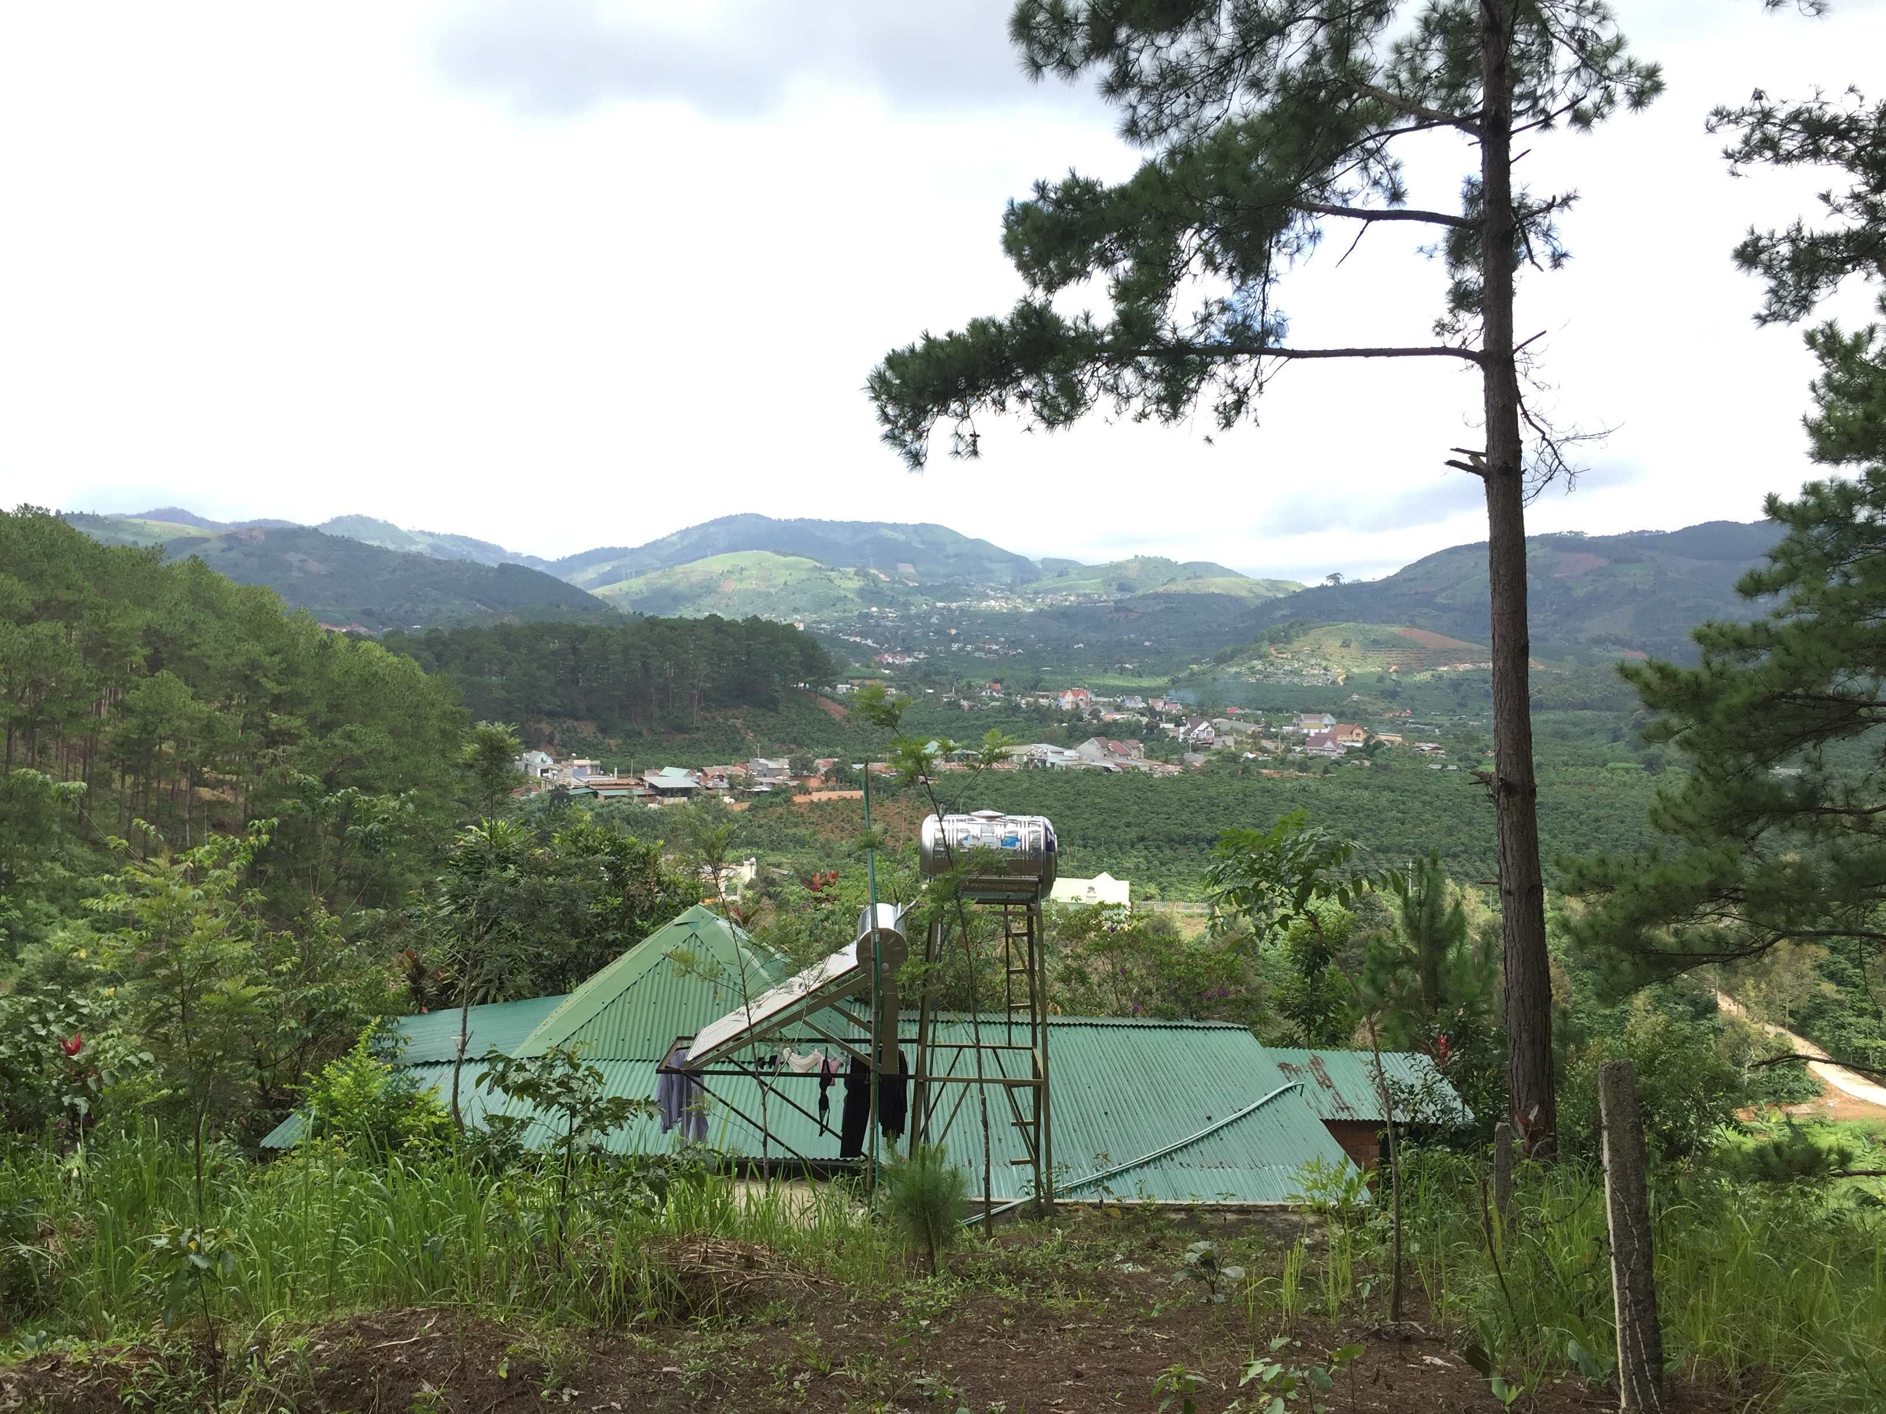
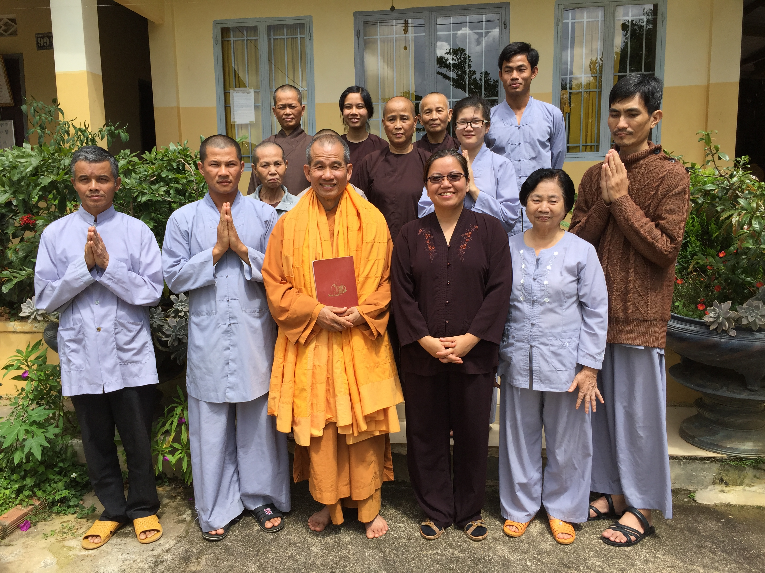
3 Gems Practice Hermit Communities
Twin Mountain Hermitage
Rural, secluded
Small self-sufficient community (by donations from local farmers)
Extended stays for monastics or laity for solitary or communal stay
Strict meditation and daily schedule
Regular support from senior teacher

Slide 17
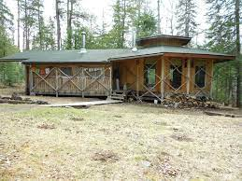
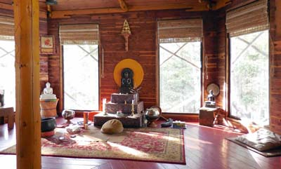
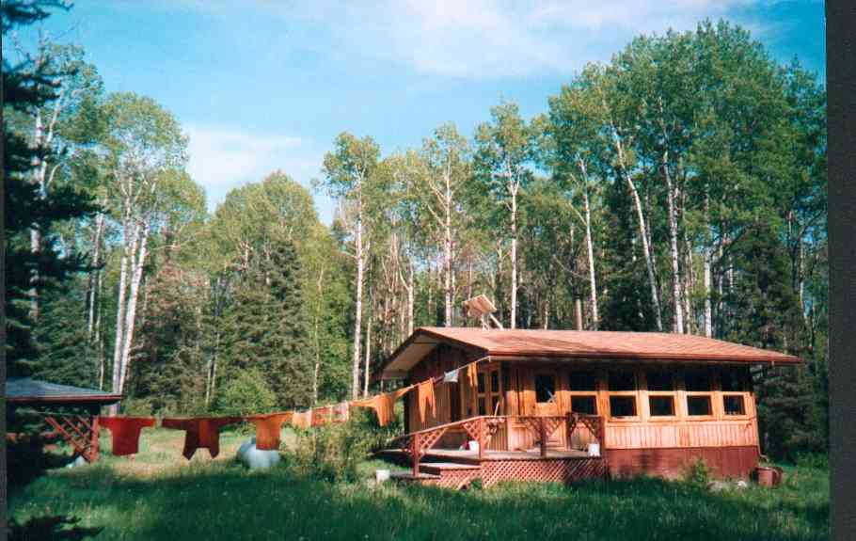
Arrow River Forest Hermitage
Generosity and meditation tradition of support like in Asia
Small but close-knit laity support community
Supportive of short or long-term stays.
Practices all principles outlined in this talk.

Slide 18
Buddhism Healing Framework
Community Responsibility
Provide a safe, supportive, harmonious environment
Practicing rituals/meditation and living together
Foster connections among members
Individual Responsibility
Open to listening, reflecting and changing (聞思修, Văn Tư Tu) behaviours
Disciplined practice of 3 trainings
Openness of one’s personal story is necessary for healing
Grief and loss are NORMAL. Sufferings are NORMAL
Learning skills through the Dharma is necessary for healing and liberation.

Slide 19
Next Week
Deep dive into personal experiences of transformation through the three training practices in Zen.
Spiritual emergence vs. spiritual emergency
Mystical, esoteric or accessible?

Slide 20
References
Abdel Aziz Mousa Thabet. “Risk and Protective Factors in Relation to Trauma and Post Traumatic Stress Disorders: A Meta-Analytic Review”. EC Psychology and Psychiatry 2.4 (2017): 122-138.
Betancourt TS, Agnew-Blais J, Gilman SE, Williams DR, Ellis BH. Past horrors, present struggles: the role of stigma in the association between war experiences and psychosocial adjustment among former child soldiers in Sierra Leone. Soc Sci Med. 2010 Jan;70(1):17-26. doi: 10.1016/j.socscimed.2009.09.038. Epub 2009 Oct 28. PMID: 19875215; PMCID: PMC3756934.
Betancourt TS, Khan KT. The mental health of children affected by armed conflict: protective processes and pathways to resilience. Int Rev Psychiatry. 2008 Jun;20(3):317-28. doi: 10.1080/09540260802090363. PMID: 18569183; PMCID: PMC2613765.
Dresler, M., & Repantis, D. (2015). Chapter 11—Cognitive Enhancement in Humans. In S. Knafo & C. Venero (Eds.), Cognitive Enhancement (pp. 273–306). Academic Press. https://doi.org/10.1016/B978-0-12-417042-1.00011-5
Flynn, D., Kells, M., & Joyce, M. (2021). Dialectical behaviour therapy: Implementation of an evidence-based intervention for borderline personality disorder in public health systems. Current Opinion in Psychology, 37, 152–157. https://doi.org/10.1016/j.copsyc.2021.01.002
Grove, J. L., & Crowell, S. E. (2018). Invalidating environments and the development of borderline personality disorder. In M. A. Swales (Ed.), The Oxford Handbook of Dialectical Behaviour Therapy (p. 0). Oxford University Press. https://doi.org/10.1093/oxfordhb/9780198758723.013.47
Homma, I., & Phillips, A. G. (2022). Chapter 6—Critical roles for breathing in the genesis and modulation of emotional states. In R. Chen & P. G. Guyenet (Eds.), Handbook of Clinical Neurology (Vol. 188, pp. 151–178). Elsevier. https://doi.org/10.1016/B978-0-323-91534-2.00011-4
Toms, G., Williams, L., Rycroft-Malone, J., Swales, M., & Feigenbaum, J. (2019). The development and theoretical application of an implementation framework for dialectical behaviour therapy: A critical literature review. Borderline Personality Disorder and Emotion Dysregulation, 6(1), 2. https://doi.org/10.1186/s40479-019-0102-7
Stanley, Phil. (2022). Applied Buddhism: The Three Trainings and the Benefit of Integrating Wisdom (Prajñā) and Ethics (Śīla) with Mindfulness in Secular Contexts (Canadian Journal of Buddhist Studies, Number 17, 2022). 17. 204-277.

