Slide 1
Buddhist Psychology: From Trauma to Enlightenment
Session 5: Three Trainings and Transformations
Presented by Lotus Vu, CCC, Zen Teacher & Psychotherapist
Clear Way Zen, Regina, Saskatchewan

Slide 2
Covered in this session
Stages of Trauma Recovery Quick Review
Three Trainings: Sila, Jhana, Sati (Precepts, Calm Abiding, Mindfulness)
Meditation Practice to Transformation
Spiritual Emergence vs. Spiritual Emergency

Slide 3
Stages of Trauma Recovery in Treatment
Safety and Stabilization
Physical and emotional safety
Learning skills to regulate emotions, grounding and coping
Creating a sense of safety
Skills: Mindfulness, sensory exercises, yoga, art, music etc.
Processing and mourning the trauma
Processing emotions and losses
Confronting trauma memories, working with grief and difficult feelings
Making sense of experience
Reconnecting and Integrating with Meaningful Narrative
Developing resilience, reconnecting with oneself and others
Rebuilding relationships and community connections
Maintaining healthy coping mechanism, building support system, pursuing personal/professional goals to facilitate integration.

Slide 4
Stabilization: Training the Mind with Ethical Boundaries (Precepts)
Sila: Precepts (Establishing Healthy Boundaries)
Non-harming
Living in harmony with the natural environment and others
Living authentically with oneself in alignment with reality (What’s happening, not what you think is happening).
Keeping oneself out of trouble and away from bad habits of body and mind
Benefits of the Precepts
Develop empathy to translate to compassion
Helps to keep mind balanced, present and not locked in anxiety or denial
Helps to build trust and good relationships with others
Establishes the foundation for meditation practice

Slide 5
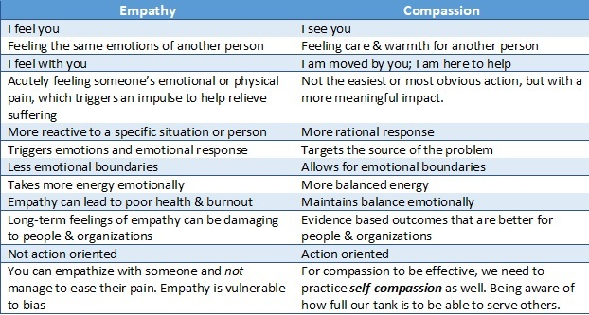
Empathy versus Compassion

Slide 6
Why develop empathy into compassion?
Psychopathy (normal people are all on the spectrum), especially for Secondary Psychopathy.
Having feelings is a good thing (if you can generate, modulate and manage them) to take practical, present, and productive actions ethically.
Altruism helps all, including ourselves.

Slide 7
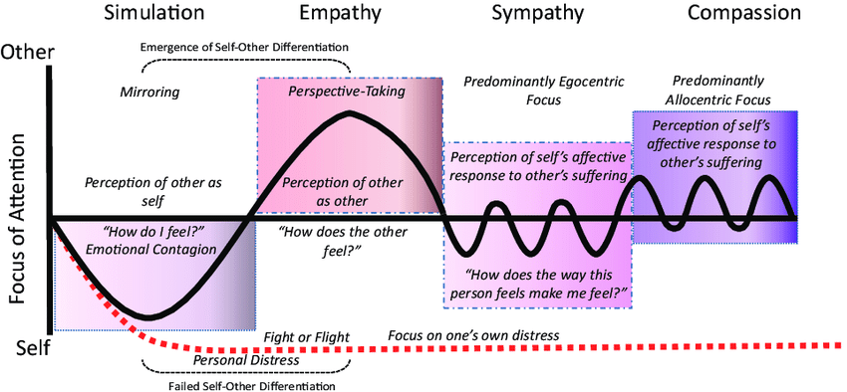
Compassion vs. Empathy
Woodruff, C. & Stevens, Larry. (2018). Where Caring for Self and Others Lives in the Brain, and How It Can Be Enhanced and Diminished: Observations on the Neuroscience of Empathy, Compassion, and Self-Compassion. 10.1016/B978-0-12-809837-0.00011-8.

Slide 8
Compassion
Self-Kindness versus Self-Judgment,
Mindfulness versus Over-Identification, and
Common Humanity versus Isolation
Compassion cannot be exhausted or become fatigued, as it resides in a state of alert attention in the present, characterized by a degree of mental clarity and calmness.

Slide 9
Sati (Mindfulness)
To be attentively aware but NOT absorbed in the object of observation (Meta-awareness)
ACT (Acceptance and Commitment Therapy) calls it Cognitive Defusion.
Requires 2 elements:
Attention and noticing attention moving
Awareness of objects that are diffused to encompass backgrounds that attention isn’t placed on.
Buddha: 4 things you can be aware of internally
Sensations from senses
Feelings
Mental States
Thoughts or mental objects

Slide 10
Jhana: Attention Training in Meditation
Zen training has its meditative practice roots in early Buddhism, focusing on the Jhanas (Calm, relaxed, aware attentive states)
Jhana -> Dhyana -> Chan -> Zen
The Jhanas and its successive levels help to clear the lens of observation to be able to experience deeper states of samadhi (tranquility) and practice rigorous and increasing clarity for meta-awareness observation (Sati/mindfulness)

Slide 11
Jhana: Attention Training in Meditation
Samadhi = To collect or bring together attention
Ekaggata = Unification of mind, mind no longer wandering
Samatha = joyful serenity that follows after complete unification of mind (through samadhi)
Absorption = State of being absorbed into an object or activity. A “good” state of absorption is best described by Mihalyi Csikszentmihalyi in his book “Flow: The psychology of Optimal Experience.”

Slide 12
Different Types of Jhanas
Zen Jhanas = Sutta Jhana (based on the earliest writings of Buddhism), most Zen practitioners practice what Culadasa calls “Ultra Light”, “Lite,” or “Light” Jhanas. In solitary meditation, the “Deep Jhanas” are accessible after Kensho.
Burmese Pak Auk Forest Monastery or Thai Forest Tradition involves Deep Jhana (arising from Visuddhimmagga, 430 A.D. in Sri Lanka by Buddhaghosa, a Buddhist Scholar)

Slide 13
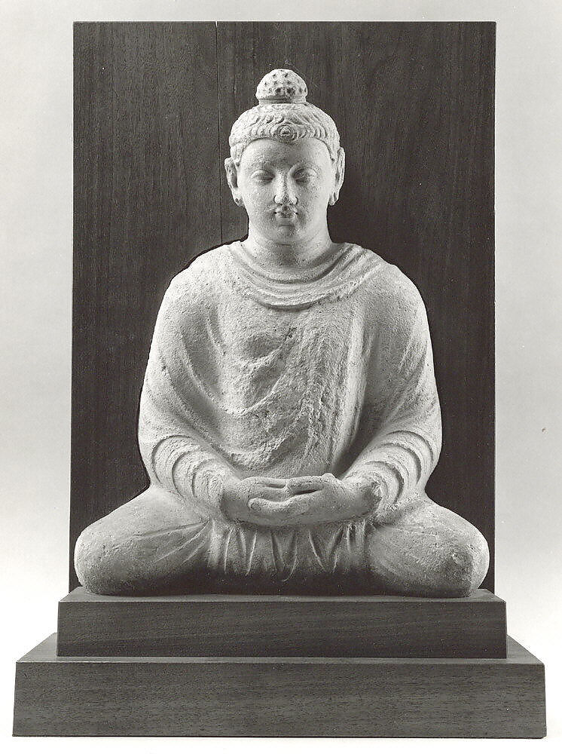
3 Trainings: Sila, Jhana, Sati
All Jhanas described were Jhanas experienced by the Buddha, but he taught Jhana with Sati (investigative dispassionate observation) to practice with Sila, not the Hindu Jhanas that he had learned before Enlightenment.
Buddha’s Jhana is a “natural state” with “relaxation” that can be experienced “off-cushion.”

Slide 14
Disclaimer: Why it’s dangerous knowledge to know the Meditative Experiences of Others and the Jhanas!
This could be YOU in meditation practice! Grasping the concepts instead of having the experience.

Slide 15
Meditative States |  | Description | Relations to 5 Aggregates
Access Concentration |  | Basic level concentration -Breath count, mindfulness of breathing, body scan, loving-kindness, mantra etc. | All present
1st Jhana | Awareness of Body & Duality | Shift attention to hold on to pleasant sensation erupts to Piti (glee) & Sukha (joy/happiness) sustained. Piti rises like gooseflesh all over the body, all your cells dancing with pure pleasure. | All Present w/ Increase feelings & sensory pleasantness
2nd Jhana |  | Background thoughts quieter/distant Inner tranquillity, unified through a calm, contented emotional experience, reduced Piti. | All present w/ Reduced feelings & increase Contentment & quietness
3rd Jhana |  | The pleasure of contentment goes away, emotionally neutral, no Piti. The body's perceptions of limbs come and go like it is not there. | Sensory experience reduced
4th Jhana |  | Steady stillness, in-distractibility, no more background thoughts A sharp mind with clarity | No thoughts
Base of Infinite Space |  | Expansive awareness, reduced awareness of body, joyous feelings of expansive freedom Loss of body awareness | No thoughts, no sensation, still subtle feelings, Perception and consciousness
Base of Infinite Consciousness | Oneness | Disappearance of object perception, everything is the watcher/observer. As if everything is pure consciousness/oneness. This is where most spiritual traditions falsely mistaken this place for enlightenment.
Base of Infinite Nothingness | Non-Duality | Cessation of Feelings and Perceptions: Non-dual state, mind very clear. Outside of meditation, if experiencing this, all labels/Perception of objects perceived falls away. | No conceptualizing, no perception no feelings, no sensory
Base of Neither Perception nor Non-Perception |  | Very reduced consciousness. Consciousness is collected in a small, dim center. Like REM sleep, mental formations appear like blurry phantom images in the background. You cannot tell what you are experiencing from the sensory input from outside.
Nirodha |  | Cessation of Perception, Feelings, and Consciousness (All Five Aggregates Absent) | No consciousness

Slide 16
Results of Practicing the 3 Trainings
Less chaotic internal environment
Understand and see your mental and behavioural patterns clearer
Understand how your mind and motivations work
Realizing you’re causing a lot of your sufferings!
Realizing that you don’t even know yourself well, never mind others.
Humility ensues

Slide 17
Arising of Unconscious Materials
Things we believe and our behaviours are two different things!
Our minds tend to deny, minimize, or repress uncomfortable experiences.
Incomplete cycles of experiencing life: arising, sustaining, changing and disappearing and letting go causes the holding of unconscious materials.

Slide 18
Common Experiences in Meditation
Anxiety (especially with past or future)
Crying, grief
Laughter, joy
Irritation, anger
Boredom, sensation seeking (of objects for mind to attach to)
Fear, existential or something perceived as real in future
Depersonalization
Derealization

Slide 19
Do you really know who you are?
A lot is happening underneath the surface and above;
we really have no idea!

Slide 20
What layers have you lost in your Zen journey?
Each layer represents a “self-process” developed out of “learning” from your environment
You have many selves!
Notes:
You got many selves

Slide 21
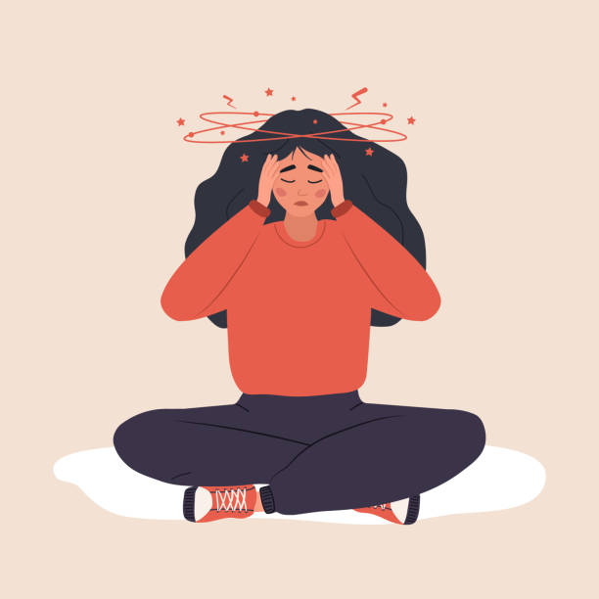
Zen Sickness

Slide 22
Zen Sickness
A phenomenon where individuals, while meditating, experience negative symptoms:
Physical symptoms caused by repressed emotional release: fatigue, headaches, sleeplessness, depression, fear or anxiety etc..
Over-identification with “Zen” identity (Ego inflation or deflation)
Detachment from own body and mind (not a psychosis or disassociation)
Solution:
Rule out any possible physical illness
Follow your teacher’s instructions
Physical exercises like Qi Gong, Chinese Herbal remedy to balance energy, and lots of walking/grounding exercise.

Slide 23
Let’s discuss some unconscious transformation experiences!

Slide 24
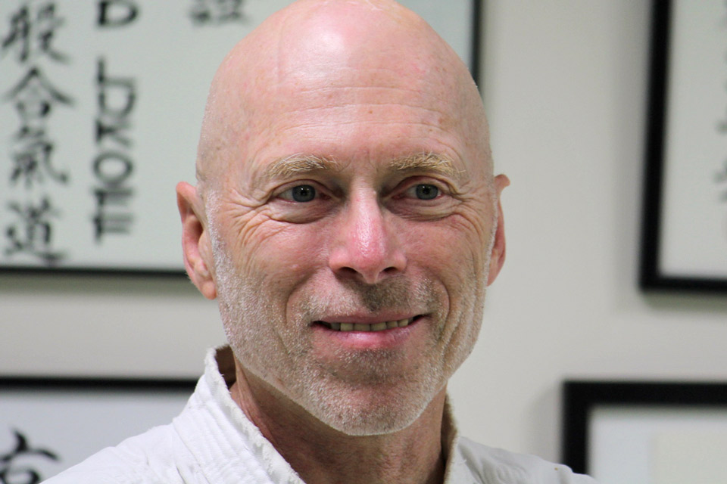
Spiritual Emergency
“In traditional societies, people who have had these spiritual emergency experiences do much better with community support in spiritual and religious contexts that better understand and support these experiences.”
Defined by Stanislav Grof in 1989, a spiritual emergency is a process involving experiences of extrasensory perception, disorganized behaviour, and unusual or illogical thoughts and beliefs containing strong spiritual content. These troubling presentations can occur when spiritual experiences are not well integrated, or progress too quickly, resulting in psychological difficulties.
David Lukoff Ph.D.
co-author of the DSM-IV category
“Religious or Spiritual Problem”
https://spiritualcompetencyacademy.com

Slide 25
Next Week
Transformation of trauma and self-process experiences in meditation

Slide 26
References
Lukoff, David. (2014). From personal experience to clinical practice to research: A career path leading to public policy changes in integrating spirituality into mental health. Spirituality in Clinical Practice. 1. 145-152.
Neff, K. (2003). The development and validation of a scale to measure self-compassion. Self and Identity, 2, 223–250.
Vieten, C., & Lukoff, D. (2022). Spiritual and religious competencies in psychology. American Psychologist, 77(1), 26–38. https://doi.org/10.1037/amp0000821
Woodruff, C. & Stevens, Larry. (2018). Where Caring for Self and Others Lives in the Brain, and How It Can Be Enhanced and Diminished: Observations on the Neuroscience of Empathy, Compassion, and Self-Compassion. 10.1016/B978-0-12-809837-0.00011-8.

