Slide 1
Buddhist Psychology: From Trauma to Enlightenment
Session 6: Transformation of Trauma and Self-Process
Presented by Lotus Vu, CCC, Zen Teacher & Psychotherapist
Clear Way Zen, Regina, Saskatchewan

Slide 2
Covered in this session
Stages of Trauma Recovery Quick Review
Six Realms of Existence
Phase 1: Safety & Stability
Phase 2: Processing (Openness & Wisdom)
Phase 3: Integration or non-duality living

Slide 3
Stages of Trauma Recovery in Treatment
Safety and Stabilization
Physical and emotional safety
Learning skills to regulate emotions, grounding and coping
Creating a sense of safety
Skills: Mindfulness, sensory exercises, yoga, art, music etc.
Processing and mourning the trauma
Processing emotions and losses
Confronting trauma memories, working with grief and difficult feelings
Making sense of experience
Reconnecting and Integrating with Meaningful Narrative
Developing resilience, reconnecting with oneself and others
Rebuilding relationships and community connections
Maintaining healthy coping mechanism, building support system, pursuing personal/professional goals to facilitate integration.

Slide 4
Review Quiz

Slide 5
Enlightenment of the Buddha
https://youtu.be/EiseKrDBVeQ?si=skWTWIRr2Dvw3OB6

Slide 6
Buddhist Cosmology: Mental States Create Realms of Existence
Depending on our states of mind, we experience these realms of existence, right here in this very life!
Our traumatized conditionings likely lead us to unwholesome realms
None of the realms are permanent and temporary depending on the persistence of conditionings

Slide 7
Notes:
Vulnerability is the key, which comes from trust

Slide 9
Jhana: Attention Training in Meditation
Zen training has its meditative practice roots in early Buddhism, focusing on the Jhanas (Calm, relaxed, aware attentive states)
Jhana -> Dhyana -> Chan -> Zen
The Jhanas and its successive levels help to clear the lens of observation to be able to experience deeper states of samadhi (tranquility) and practice rigorous and increasing clarity for meta-awareness observation (Sati/mindfulness)

Slide 10
Map of Buddhist Trauma Therapy
FEAR and IMPAIRED ATTENTION characterize PTSD, requiring relational grounding to begin healing.
Healing and processing begins with:
Enough attentional stability to say with trauma material in exposure for the processing to happen.
Non-attachment and clarity into the trauma material and process leading to insight which leads to further clearing out of the traumatic materials
Zen meditation solitary retreat is probably the most intense exposure therapy to the mental traumatic content that you’ll experience!

Slide 11
Buddhist Practice to Transform Everyday Patterns Developed Through Trauma & Conditioning

Slide 12
Elements of Zen Meditative Practice
Attention training develops stability of attention (Jhana/Samatha)
Stability develops clear observation (Sati)
Clear observations combined with active inquiry and reflection develop insights which lead to wisdom (paññā/ prajñā)
Wisdom is a clear direct experiential understanding of the three characteristics (impermanence, dissatisfaction and non-self) which in the realization of Non-Self one experiences Kensho/Satori (or Stream Entry)
Wisdom is seeing through the process of self-identification or self-ing process of Dependent Origination
Wisdom is an intuitive knowing of what is present without thoughts or judgments, always present and accessible

Slide 13
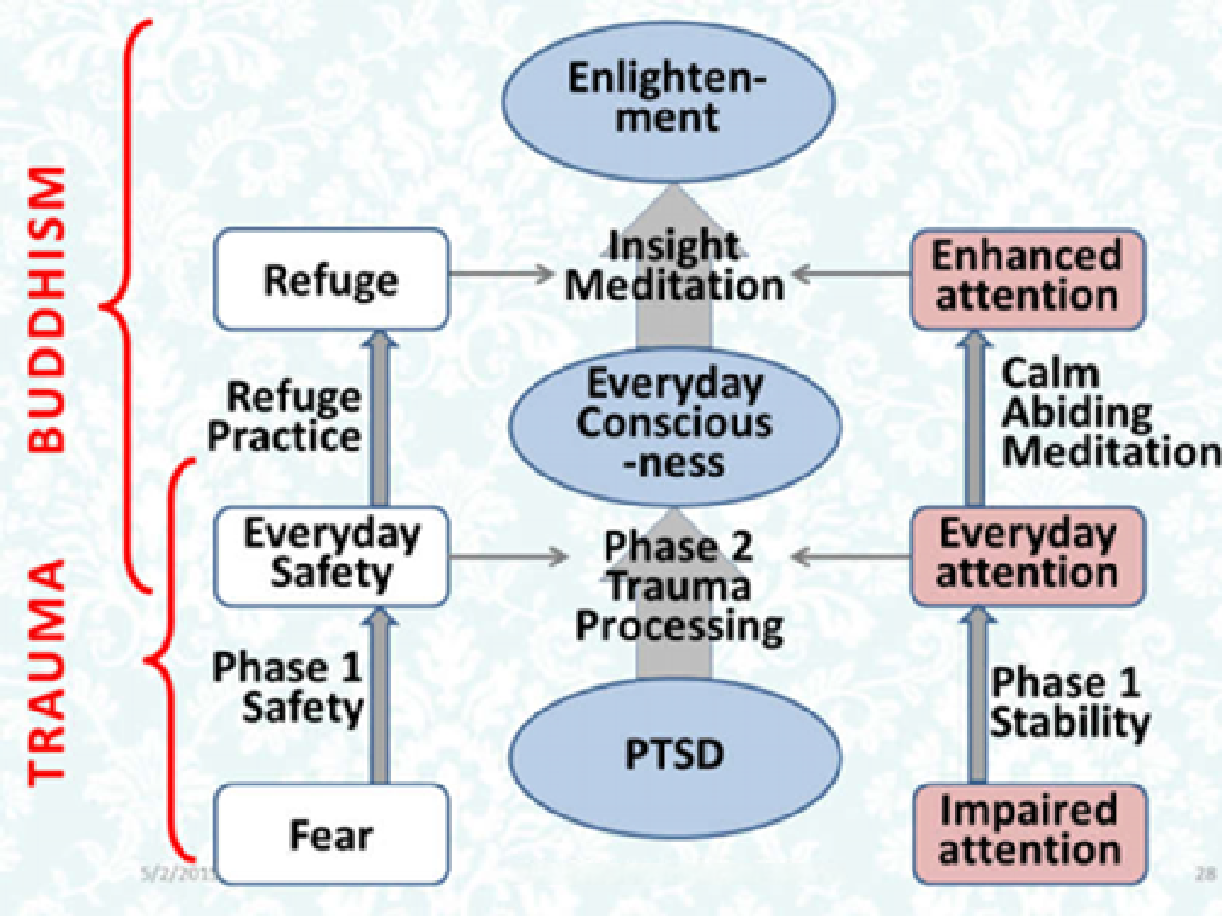

Slide 14
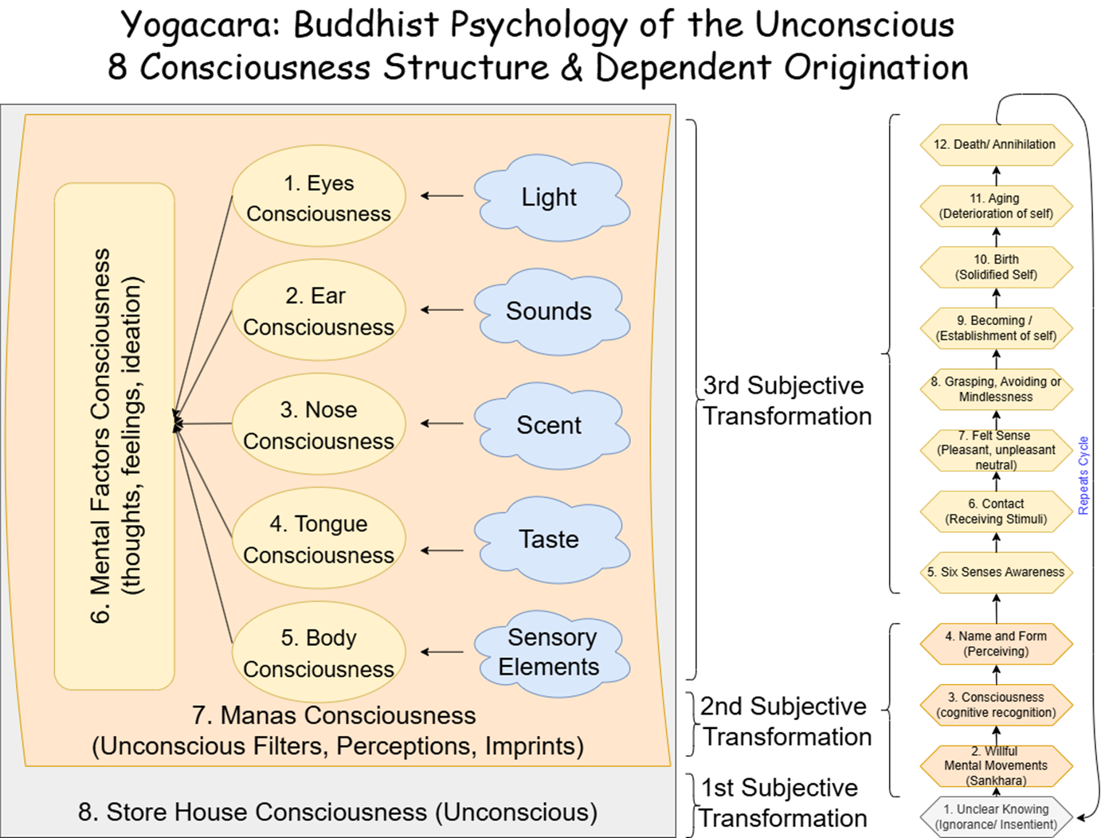

Slide 15
Meditative States |  | Description | Relations to 5 Aggregates
Access Concentration |  | Basic level concentration -Breath count, mindfulness of breathing, body scan, loving-kindness, mantra etc. | All present
1st Jhana | Awareness of Body & Duality | Shift attention to hold on to pleasant sensation erupts to Piti (glee) & Sukha (joy/happiness) sustained. Piti rises like gooseflesh all over the body, all your cells dancing with pure pleasure. | All Present w/ Increase feelings & sensory pleasantness
2nd Jhana |  | Background thoughts quieter/distant Inner tranquillity, unified through a calm, contented emotional experience, reduced Piti. | All present w/ Reduced feelings & increase Contentment & quietness
3rd Jhana |  | The pleasure of contentment goes away, emotionally neutral, no Piti. The body's perceptions of limbs come and go like it is not there. | Sensory experience reduced
4th Jhana |  | Steady stillness, in-distractibility, no more background thoughts A sharp mind with clarity | No thoughts
Base of Infinite Space |  | Expansive awareness, reduced awareness of body, joyous feelings of expansive freedom Loss of body awareness | No thoughts, no sensation, still subtle feelings, Perception and consciousness
Base of Infinite Consciousness | Oneness | Disappearance of object perception, everything is the watcher/observer. As if everything is pure consciousness/oneness. This is where most spiritual traditions falsely mistaken this place for enlightenment.
Base of Infinite Nothingness | Non-Duality | Cessation of Feelings and Perceptions: Non-dual state, mind very clear. Outside of meditation, if experiencing this, all labels/Perception of objects perceived falls away. | No conceptualizing, no perception no feelings, no sensory
Base of Neither Perception nor Non-Perception |  | Very reduced consciousness. Consciousness is collected in a small, dim center. Like REM sleep, mental formations appear like blurry phantom images in the background. You cannot tell what you are experiencing from the sensory input from outside.
Nirodha |  | Cessation of Perception, Feelings, and Consciousness (All Five Aggregates Absent) | No consciousness

Slide 16
Igniting the Path: Satori/Kensho
Satori – Japanese for “Ah Ha” or “understand”
Kensho – “Seeing your true nature.”
Stream Entry – The first stage of Buddhism’s 4 stages to liberation, or the true beginning of the Buddhist Path.
Without Kensho, it’s challenging to experience steadily repeated experiences of Arupas or Formless Jhanas.The formless Jhanas help to propel the clearing out of unconscious materials through deep observation and reflection.
With a lack of faith in the path or continually re-experiencing non-duality after the first initial Kensho experience, a practitioner can go back to previous conditioning and identification with self-process.

Slide 17
Practicing the Zen Path
Preparatory Practice: Loving Kindness, Access Concentration, Forgiveness, Repentance, Generosity etc…
Kensho or Stream Entry to begin the transformation of the self-process
Understand and see clearer your behavioural patterns
Clear out chaotic internal environment
Understand your mind and motivations
Realizing the three marks of existence
Complete letting go of all conceptual or perceptual clinging which distorts reality

Slide 18
Next Week
Wrap up the course with the final destination!
What does liberation look like?
Is it optimal well-being?
A comparative perspective to Positive Psychology

