Slide 1
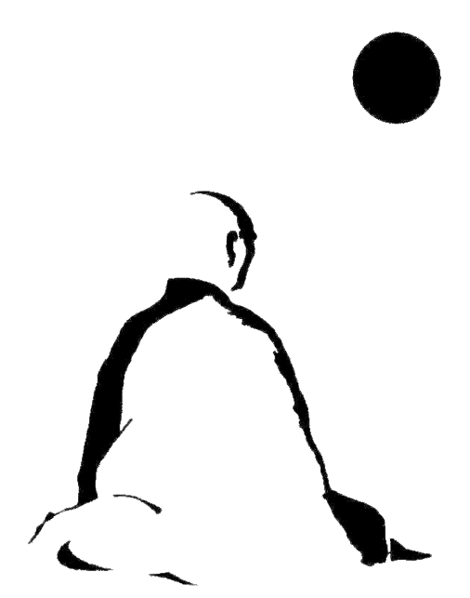
Buddhist Psychology: From Trauma to Enlightenment
Session 7: Optimal Experience or Gates of Liberation?
Presented by Lotus Vu, CCC, Zen Teacher & Psychotherapist
Clear Way Zen, Regina, Saskatchewan

Slide 2
Covered in this session
Positive Psychology of Well-Being
Comparing between Clinical, Positive Psychology and Buddhism
Pillars of Positive Psychology and Buddhism’s Well-Being
Psychology of Flow vs. Wu Wei vs. Non-Dual Experience
The 3 Gates of Liberation

Slide 3
Positive Psychology
A school of psychology focused on what creates/enhance happiness and well-being.
Famous proponents are Martin Seligman, Mihaly Csikszentmihalyi and Tal Ben-Shahar.

Slide 4
Clinical Psychology and Positive Psychology – A Brief Comparative Analysis
Clinical Psychology | Positive Psychology
1. Focuses on symptoms and challenges to reach a solution. | 1. Focuses on positive thoughts, emotions, and actions to reach a solution.
2. Aims to validate theories and put pieces of evidence together to explain and treat a mental condition. | 2. Aims to promote happiness and operates on principles that support wellbeing.
3. Digs into the past to explore the causal factors. | 3. Explores the present and the future to find better ways of living.
4. Includes areas like education, learning disabilities, depression, stress, addiction, trauma, etc. | 4. Includes areas of strength, virtues, talents, abilities, and self-enhancement.
5. Operates in the presence of a problem. | 5. Operates with or without psychopathology.
6. Is preventive and recovery-oriented. | 6. Is preventive and precautionary.

Slide 5
Positive Psychology and Buddhism – A Brief Comparative Analysis
Buddhism | Positive Psychology
1. Focuses on increasing positive emotions and tolerating negative ones to release it | 1. Focuses on positive thoughts, emotions, and actions to reach a solution.
2. Aims to promote self-exploration through introspection and meditation, and strengthen connections with others. | 2. Aims to promote happiness and operates on principles that support wellbeing.
3. Understand the present, but be mindful of past patterns in the present and present actions that affect the future. | 3. Explores the present and the future to find better ways of living.
4. Includes all areas of life from personal, professional, social and spiritual while observing the present to gain insights into these aspects. | 4. Includes areas of strength, virtues, talents, abilities, and self-enhancement.
5. Operates without psychopathologizing sufferings. | 5. Operates with or without psychopathology.
6. Is understanding, acceptance and change, that’s recovery, preventative and precautionary oriented. | 6. Is preventive and precautionary.

Slide 6
Enlightenment of the Buddha
https://youtu.be/EiseKrDBVeQ?si=skWTWIRr2Dvw3OB6

Slide 7
Positive Psychology
4 Burgers

Slide 8
Pillars of Positive Psychology that Improves Mental Health
Focus on the positives/ Count your blessing
Practice gratitude!
Learning from negative experiences
Mindfulness
Healthy lifestyle (exercise, food, good sleep, good company)
Monitor your moods and emotions: understand them!

Slide 9
Pillars of Buddhism’s Well-Being
Walk everyday (as the Buddha did 20 km a day) or exercise daily.
Eat healthy (1 meal a day or OMAD fasting, vegetarianism)
Meditation (Jhanas, Mindfulness, Loving-kindness etc..)
Reflections/recollections: learning from negative and positive experiences by observing them deeply and dispassionately.
Keep out of trouble (follow the precepts)
Keep good company for support (helpful friends, sangha and teacher)

Slide 10
The Psychology of Flow
https://youtu.be/74Wei0-vAZs?si=SSj9jcuPcx_swjSe

Slide 11
Wu Wei (Non-Doing)
https://youtu.be/NvZi7ZV-SWI?si=zg5qs1Z4l_RhAUzw

Slide 12
Flow vs. Non-dual Experience
Flow | Non-dual (non-doing/Wu-Wei)
Effortless | Effortless
Concentrated and Absorbed | Open and aware (non-absorbed)
Timeless | Timeless
Pleasurable | No-pleasure
Non-goal oriented | Non-goal oriented
With practice and skills (not too difficult, not too hard) | Non-attached to results, doesn’t require skills or practice
Object oriented | Non-object oriented (lack of perceptual schemas)
Self-process temporarily paused | Self-processes can happen, but it doesn’t affect experience.
Doesn’t require wisdom or insights | Requires wisdom and/or insights to enter

Slide 13
Three Gates of Liberation
Emptiness or Non-self
Signlessness (absence of characteristics)
Aimlessness or Desirelessness

Slide 14
Prizes

Slide 15
Generosity
Make this course happen again for others:
Consider donating to the sangha via reginazensangha@gmail.com
Consider appreciating Lotus by donating to lotusvu@clearwayzen.ca

